Slide 1


Slide 2

Edged Weapons
Instructor:
Date:

Slide 3
OBJECTIVES
Topic: Edged Weapons
Objectives: (Classroom)
  Knowledge of basic lines, levels of attack
  Defenses to:
    Long
    Mid
    Short distance weapon attacks

Slide 4
OBJECTIVES
Method Of Instruction: Lecture development, practical application, written exam
Training Aides: Rubber knives, red guns, chalk
Pen and paper are required

Slide 5
Characteristics
  Most edged weapons attacks are:
    Totally unexpected
    Take place at close rage
    Make it difficult to make a real threat assessment

Slide 6
Characteristics
  Most edged weapons at close range are superior to firearms – why?:
  Never run out of ammunition
  Never jams
  Never misfires
  Rarely misses the target
  Cuts bone, tendon, arteries and veins in one thrust
  Can bring sudden shock
  Superior concealment
  Readily available
  Occupies a permanent wound channel until extracted.

Slide 7
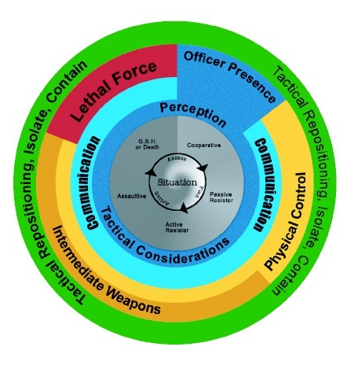
Legal Considerations

Slide 8
Legal Considerations
Most knife attacks have the potential to be lethal. Therefore, Lethal Force Options are available. To use lethal force you must have.
  Weapon
  Intent
  Delivery System

Slide 9
Legal Considerations
Modern Police doctrine states that an edged weapon attack will be met with Lethal Force, most usually a firearm. However, it has been proven that if an assailant is within 21’ of an Officer, that a firearm may not be able to be drawn in time.

Slide 10
Stats
24% of all serious injuries experienced by crime victims were from edged weapns vs. 13% firearms
Fatality rate for officers stabbed is 30% vs. 10% firearms
Canada – 2004 – 33% of all homicides were committed with a knife
Aggravated assaults - 28.7% knife vs. 2.5% firearm

Slide 11
Stats
Robbery – 20.6% knife vs. 14.6% firearm (or replica)
Every house in North America has some form of edged weapon
Most popular homemade weapons in prison are designed to cut or pierce.

Slide 12
Assault Dynamics
  Research shows:
    Victims are usually involved with a physical encounter long before they realize a knife is being used
    Most victims see a thrust of slash as a punch, slap or kick.
    Hard to differentiate between empty hand assaults and edged weapon attacks.

Slide 13
Assault Dynamics
  Typical depth of a fatal stab is 2.0 to 3.5 cm through the rib cage
  Most victims suffer multiple wounds. Fatal wounds tend to be the last few in the attack.
  Short blades can penetrate the abdomen up to 8-10 cm.
  3 cm allows penetration through the ribs
  4cm allows penetration to the heart
  Knives creates TONS of energy per square inch

Slide 14
Pre-Assault Cues
Can include:
  Sound of unsnapping of a button on knife case
  Sound of velcro opening
  Sound of knife blade locking
  Movement from behind the back
  Drawing motion with arm / elbow
  Palming
  Knife case on belt
  Best defense to be prepared, watch the hands!
  Have a plan in place, practice it!

Slide 15
Defense Systems
  Most systems fail with edged weapons – why?
    Assumes defenders knows the attacker has an edged weapon
    Instructs complicated techniques (motor skills under stress)
    Concentrates on controlling the knife / knife hand
    Designed to be used against static, singular attacks
    Assumes the defender knows the difference between weapon / empty hand attacks

Slide 16
Defense Systems
  Successful components include:
  Awareness strategies
    Most assaults are spontaneous
    Most assaults are close range
  Realistic hands on tactics
    Weapon readiness
    Defenses with personal weapons
    “Anything Goes” tactics
  “Bread and Butter” response

Slide 17
Defense Systems
  Bread and Butter response:
    Most attacks are spontaneous
    We have to think about a response – this can mean the difference between winning and losing
    Most systems have multiple responses based on attackers actions
  Bread and butter responses are:
    Spinal tuned (instinct)
    Based on the situation
    Simple – creates space

Slide 18
Basic Defense Steps
  Create Space
    Bread and Butter response creates space
    Draw your baton – only strike if the subject continues assault
    Give commands
    Reassess

Slide 19
Basic Defense Steps
  Get off the line of attack
    Allows you to go on the offensive
    Get your hands up
    LATERAL movement is preferred when dealing with edged weapons

Slide 20
Basic Defense Steps
  Steps for survival
    Maintain proper mindset – you will win!
    Neutralize the line of attack – limit strikes you take
    Be AGGRESSIVE in your defense.

Slide 21
Basic Defense Steps
  Pat / Wrap / Attack
    Used with close range, spontaneous attacks
    Controls the delivery system (arm) – First strike is delivered to forearm holding the weapon.
    Good with ground attacks

Slide 22
Basic Defense Steps
  Alternatives
    Take downs
    Creating space
    Using baton / firearms / weapons of opportunity
    Run away
    Ground defenses

Slide 23
Basic Defense Steps
  If you are cut:
    Do not panic
    Slow your breathing
    Inspect yourself for injuries
    If limbs are injured, elevate
    If a lung is punctured, exhale and use airtight article to seal the wound
    I AM GOING TO LIVE

Slide 24
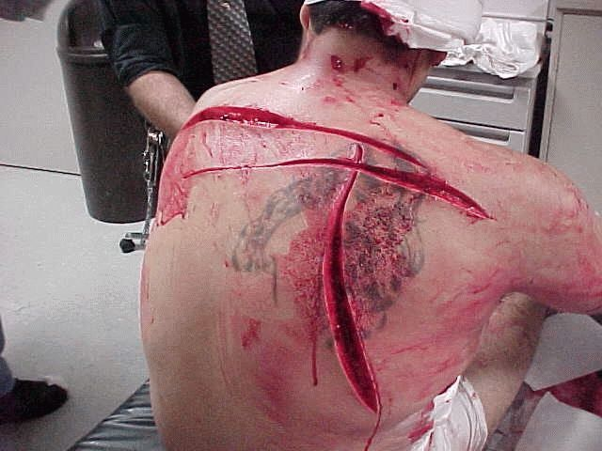

Slide 25
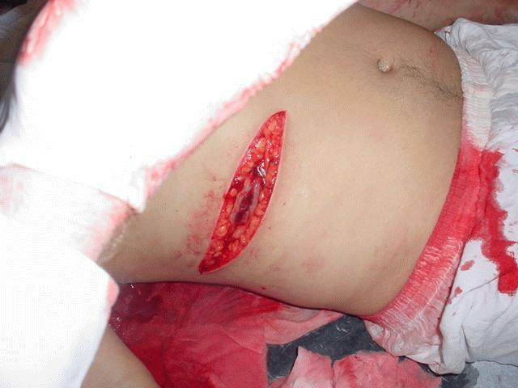

Slide 26
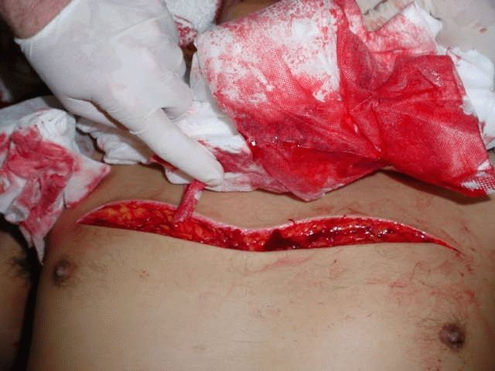

Slide 27
Summary
We have learned:
  The basic principal of movement
  The “Pat-Pat” System
  Legal considerations of defending against edged weapons

